Slide 1
Connecting Today’s Rotarians
Julie Aubry Regional Membership Officer
Zones 21b, 27, 7b, and 8
November 2015
Notes:
Good afternoon everyone.
I’m going to give you’re a brief overview of the Young Professionals Campaign and talk about one of the most exciting things that we have done in the campaign thus far.

Slide 2
Young Professionals Campaign
The Young Professionals Campaign provides a unique opportunity to:
learn more about young professionals
identify the challenges that clubs have attracting young professionals
develop new ideas and innovative strategies
Notes:
The campaign is a unique opportunity for Rotary to connect with young professionals (ages 25-40) and learn about their perceptions of Rotary. Using a multi-phase approach, we’ve incorporated research, social media outreach, and testing of new creative concepts, Rotary is learning more and more about this demographic, identifying challenges that clubs have attracting young professionals, and as a result, working to develop new ideas and innovative strategies to increase this important membership segment in Rotary clubs.
The campaign is a direct result of a generous donation from a major donor, and is being led by a team of Rotary staff. We have created a multi-phase approach that has enabled us to use various techniques as we engage with this demographic . Due to the nature of the donation, activities are currently limited to the United States. Although our activities and findings have occurred in the US, our young professionals findings and research support major conclusions from studies and focus groups conducted worldwide.

Slide 3
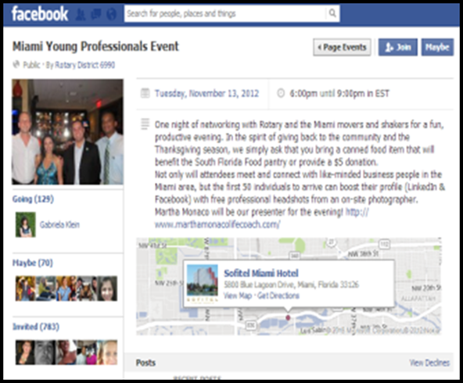
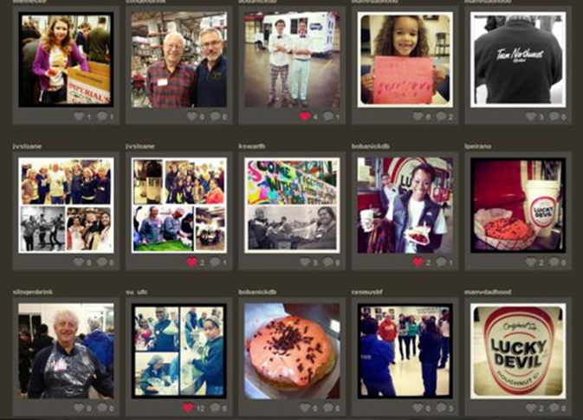
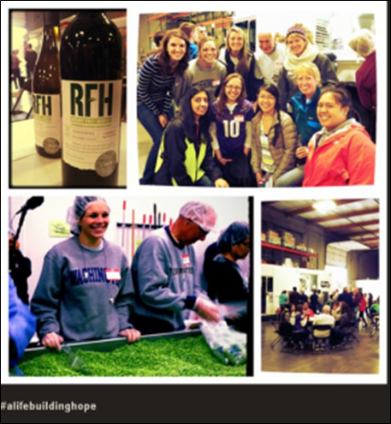
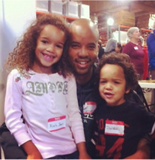
Campaign Phases
Phase 1: Social media and service projects
Phase 2: Focus groups
Phase 3: Young Professionals Summit
Notes:
In phase 1, we used social media to connect with young professionals and increase their awareness of Rotary. We identified three areas within the United States with a strong growth potential of young professionals and worked with districts to modify existing Rotary service projects and events to create opportunities where prospective members could speak with Rotarians and experience Rotary outside of a traditional club meeting. Here is a snapshot from our social media exposure including conversations on Facebook, Twitter, Vimeo, Instagram and several blogs all highlighting Rotary and Rotary events.
We worked closely with districts to develop events where nearly 100 non-Rotarians Yps
attended these events and were able to engage with Rotary and Rotaract members before being invited to a traditional club meeting.
In phase 2, we wanted to take our findings and build from there. As a result, we worked with an advertising agency in Chicago, Schaefer Condon and Carter, who created 4 distinct concepts combining Rotary’s service focus and its valuable connections and friendships.
We utilized focus groups to test them and see how they resonated with young professionals. We did 12 focus groups in total, and visited six different locations in the United States… The goal was to get variety, and interview a good cross-section of young professionals. Participants came from all over - big cities and smaller towns. Men and women were interviewed separately, and close to 100 young professionals participated.
So who exactly is the young professional? We are focusing on the 40 and under, post-college group, so age 25-40 was the target. This is the next generation of Rotarians. And honestly, we had group after group of young professionals who would have made great Rotarians. Architects, pharmacists, lawyers, business people… These were accomplished, go-getters, and just the kind of people we wanted. So what did we learn? And we moved into Phase 3

Slide 4
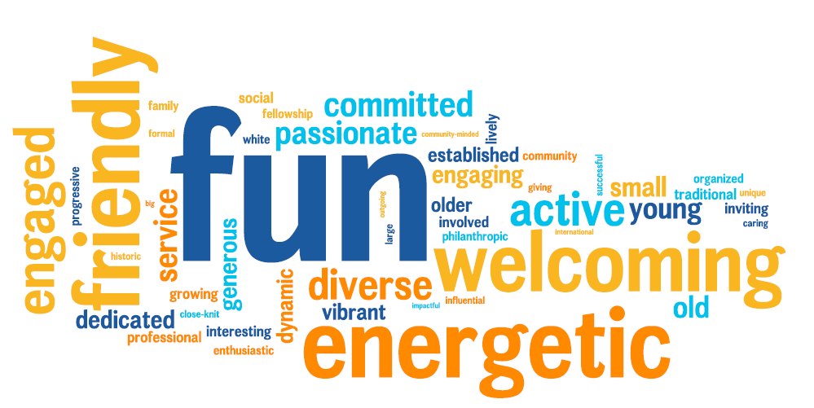
Chicago Young Professionals Summit
Notes:
So, we decided to host the Young Professionals Summit, which took place on 26-27 September in Chicago. Out of over 130 applicants from across the US, we gave 32 young leaders the chance to share their thoughts, reflect on their stories, and exchange ideas. This group was very engaged, excited, and honestly, really honored to have this opportunity to share their ideas and experiences with others from across the US.
Through a facilitated discussion called Appreciative Inquiry, we discovered what’s working now, worked to identify solutions to challenges, and thought of ways to amplify our positive experiences so that even more young professionals can discover Rotary. We’ve asked each participants to connect with their district governors after the event to share their experience, as well as discuss possible strategies that they would like to implement in their clubs.

Slide 5
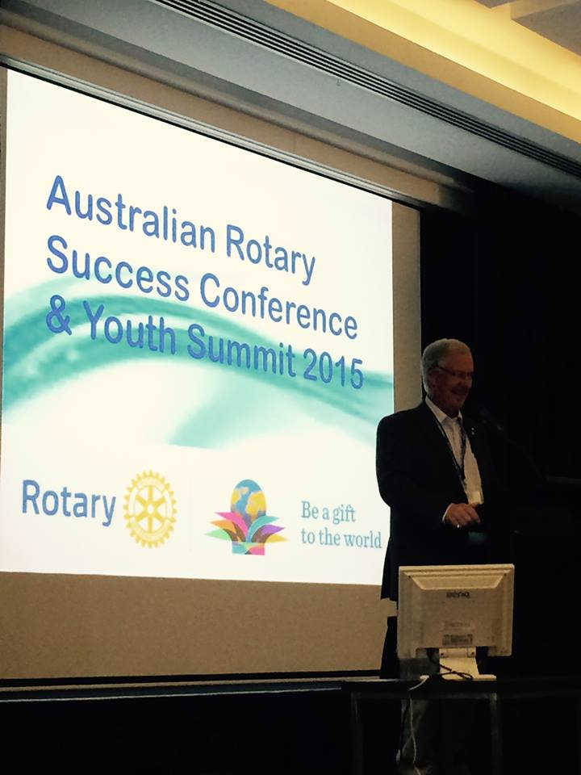
Youth Summit 2015 in Canberra, Australia
Common Themes for Young Professionals:
They don’t know what Rotary is
Polio Eradication is not a draw into Rotary
A need to bridge the gap between Programs and Clubs
Some clubs unwelcoming/ not open to change
Interested in leadership opportunities

Slide 6
Attracting Younger Professionals
Assign a veteran Rotarian to serve as a mentor to make a new young member feel welcome.
Reduce meal expenses or make meals optional
Create a welcoming club environment
Create social and networking activities that are interesting and convenient
Get them involved
- Strengthening Your Membership: Creating Your Membership Development Plan
Notes:
Create a satellite club with an alternate meeting time or format more convenient for prospective members with young families. Consider a Saturday morning meeting or a satellite e-club.
Reduce meal expenses or make meals optional
Create a welcoming club environment that is accepting of absences. Perfect attendance is typically not attainable for today’s professionals. This may require some changes in your club’s traditions or policies
Create social and networking activities that are interesting and convenient
Get them involved. Young professionals are creative and eager to generate new ideas for solving persistent problems.

Slide 7
Alumni and Program Participants
Great resource for membership
Build and maintain relationships with alumni and their families
Alumni and Program Participants information available

Slide 8
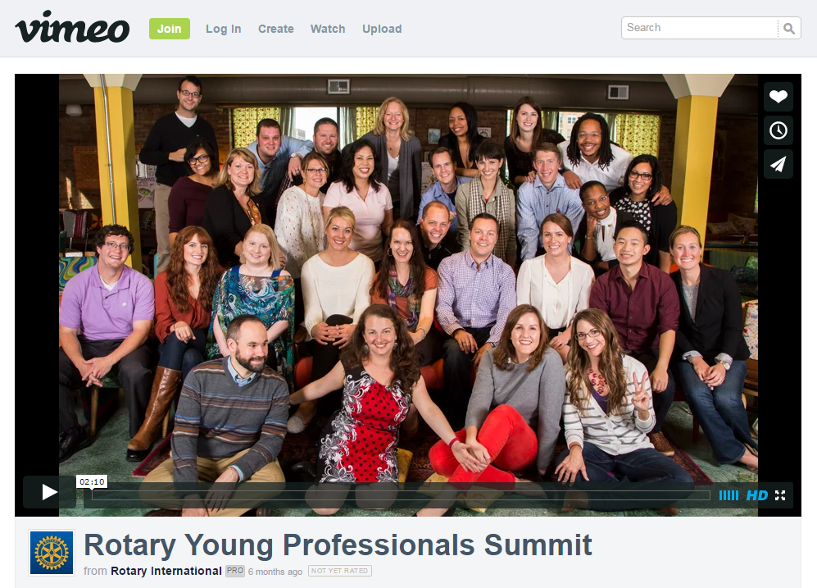
Resources for YP Summits

Slide 9
THANK YOU
DISCUSSION
Notes:
(10 mins)
Time to get

